Slide 1
Optimal Rectangle Packing:
A Meta-CSP Approach
By Michael D. Moffitt and Martha E. Pollack, AAAI 2006
Chris Reeson
Advanced Constraint Processing
Fall 2009

Slide 2
Overview
Overview of the problem
Techniques
  Traditional
    Forward Checking
    Removal of Subsumed Variables
    Semantic Branching
  Domain Specific
    Dynamic Symmetry Breaking
    Detecting Cliques of Displacement
    Variable and value ordering
Experimental Results
  Solving the optimization problem

Slide 3
The Task
The task is to “pack rectangles”
Two computational problems
  Optimization: Minimal Bounding Box Problem
  Satisfaction: Containment Problem
x
0,0
y
3x4
4x4

Slide 4
Minimal Bounding Box
Given: A set of N rectangles of dimensions w_{i}×h_{i}
Find: The values of x_{i} and y_{i} which are the position of rectangle i such that
  No two rectangles overlap &
  Area of bounding box is minimal
w_{i}
4x4
4x2
h_{i}
4x4
2x2
Slack
Bounding box

Slide 5
Containment Problem
Given:
  An enclosing space of dimensions W×H
  A set of N rectangles of dimensions w_{i}×h_{i}
Find: The values of x_{i} and y_{i} which are the position of rectangle i such that
  No two rectangles overlap &
  All rectangles are inside the enclosing space
In reality, we do not need to find the values of x_{i} and y_{i} but the relative positions of rectangles
→ ‘floating configuration’
4x4
4x4
4x4
4x4
4x4
4x4
Consistent solution
Inconsistent solution

Slide 6
Containment Problem: CSP Model
Variables
  For each rectangle, two variables x_{i}, y_{i} 1≤i≤N
Constraints
  Containment constraints (unary)
    0 ≤ x_{i} , 0 ≤ y_{i}
    x_{i} + w_{i} ≤ W
    y_{i} + h_{i} ≤ H
  Overlap constraints (binary)
    (L) i is to the left of j: x_{i} + w_{i} ≤ x_{j}
    (R) i is to the right of j: x_{j} + w_{j} ≤ x_{i}
    (A) i is above j: y_{i} + h_{i} ≤ y_{j}
    (B) i is below j: y_{j} + h_{j} ≤ y_{i}
0,0
5
1
4
Containment constraints
W=8 H=8
w_{i}=4 x_{i}=5
h_{i}=4 y_{i}=1
0 ≤ 7, 0 ≤ 1
5 + 4 ≤ 8
1 + 4 ≤ 8
Horizontal disjuncts
Vertical disjuncts

Slide 7
Constraint Network
  x₁ + w₁ ≤ x₂ ∨
  x₂ + w₂ ≤ x₁ ∨
  y₁ + h₁ ≤ y₂ ∨ y₂ + h₂ ≤ y₁
Containment constraints (unary constraints)
  0 ≤ x_{i} , 0 ≤ y_{i}
  x_{i} + w_{i} ≤ W
  y_{i} + h_{i} ≤ H
Non-overlap constraints (binary constraints)
  (L) i is to the left of j: x_{i} + w_{i} ≤ x_{j}
  (R) i is to the right of j: x_{j} + w_{j} ≤ x_{i}
  (A) i is above j: y_{i} + h_{i} ≤ y_{j}
  (B) i is below j: y_{j} + h_{j} ≤ y_{i}
x₁
x₂
x₃
y₁
y₂
1
  y₃+h₃≤H
2
3
y₃
4x3
4x3
3x3
0≤y₃

Slide 8
The Meta CSP
Model
  Variables: all non-overlap constraints
  Domains: 4 linear inequalities (Left, Right, Above, Below)
  One global constraint requiring one linear inequality from each meta variable
Solved by search, finding one solution: ‘floating configuration’
  Floyd-Warshall determines the consistency (and minimality) of system of linear inequalities
1
2
3
  L: x₁ + w₁ ≤ x₂ R: x₂ + w₂ ≤ x₁
  A: y₁ + h₁ ≤ y₂
  B: y₂ + h₂ ≤ y₁
C_{1,2}
Root
4
4x3
3
C_{1,2}
L
System of inequalities is consistent
C_{1,3}
L
R
A
C_{2,3}
{L, R, A, B}
C_{2,3}
L R A B
L R A B
C_{1,3}
{L, R, A, B}

Slide 9
The Distance Graph
Similar to Simple Temporal Problem
The positional variables from the original CSP are the nodes in this graph
Solved with F-W
C_{1,2}
C_{1,2}← R:
1 to the right of 2
x₁ + 4 ≤ x₂
  L: x₁ + w₁ ≤ x₂ R: x₂ + w₂ ≤ x₁
  A: y₁ + h₁ ≤ y₂
  B: y₂ + h₂ ≤ y₁
x₁
y₁
7
-4
-4
8
-4
-4
-3
W
x₂
y₂
H
1
7
8
2
3
-3
-3
4x4
C_{2,3}
{L, R, A, B}
7
8
x₃
y₃
4x3
3x3
C_{1,3}
{L, R, A, B}

Slide 10
Forward Checking
Used to eliminate values from variables before they are even expanded
1
2
3
4x4
  L: x₁ + w₁ ≤ x₂ R: x₂ + w₂ ≤ x₁
  A: y₁ + h₁ ≤ y₂
  B: y₂ + h₂ ≤ y₁
C_{1,2}
4x3
3x3
C_{2,3}
{L, R, A, B}
C_{1,3}
{L, R, A, B}

Slide 11
Removal of Subsumed Variables
Make implicit assignments explicit
C_{2,4} ← B
C_{1,2} ← B
4
4
2
3
4x3
1
4x4
C_{1,4} ← B
4x3
3x3
1
1
 | y₁ | y₂ | y₃ | y₄
y₁ | - | -4 | 5 | -7
y₂ | 5 | - | 5 | -3
y₃ | 5 | 5 | - | 5
y₄ | 7 | 7 | 7 | -
y₁
-4
-4
8
-3
-3
y₂
8
H
8
y₃
-3
-1
8
y₄

Slide 12
Semantic Branching
When assigning a disjunct fails in a path, add the negation of the disjunct
Allows for tighter path lengths
1
2
3
Try: C_{1,2} ← L
4
x₁
y₁
4x3
3
4
4x3
7
-4
-4
8
-4
-4
-3
W
7
x₂
y₂
8
H
-3
-3
7
8
x₃
y₃
When C_{1,2}← A, we can keep the negation of
C_{1,2}←L = x₂ + 4 ≤ x₁
¬(C_{1,2}←L) = x₂ + 4 > x₁
= x₂ + 3 ≤ x₁
x₁
y₁
7
-4
-4
-4
8
-4
-3
-3
W
7
x₂
y₂
8
H
-3
-3
7
8
x₃
y₃

Slide 13
Dynamic Symmetry Breaking
Every constraint has
  2 vertical disjuncts &
  2 horizontal disjuncts
Because of symmetry, we only need to consider
  1 vertical disjunct &
  1 horizontal disjunct
When a given disjunct fails, the other can be safely pruned
A
A
D
D
B
B
C
C
If C_{1,2} ←L fails…
C_{1,2} ← R will also fail
4
4x3
4x3
4

Slide 14
Tracking Cliques of Displacement (1)
Scenario
  A set of rectangles is such that the sum of their widths/heights exceeds the width/height of enclosing space
  Every horizontal/vertical arrangement of those rectangles will fail
Situation detected with Displacement Graph
  One graph for vertical displacement
  One graph for horizontal displacement
4
2
3
1
4x4
4x3
4x3
1

Slide 15
Tracking Cliques of Displacement (2)
4
2
3
1
4x4
Displacement graph
  One vertex for each rectangle
  Edges are added when
    An assignment is done
    Only horizontal/vertical disjuncts remain
If the maximum weighted clique exceeds W/H, no solution exists
Operation
  Build graph
  Add edges before each assignment is made
  Checks graph for max weighted clique (NP-Hard!!)
  Backracks if weight exceeds W/H…
4x3
4x3
1
1
1
7
3
2
8
3
3
4
4
1
4
4
4
1
2
3
4

Slide 16
Tracking Cliques of Displacement (3)
4
2
3
Example
1
4x4
4x3
4x3
1
C_{1,2}
{L, R, A, B}
C_{1,3}
{L, R, A, B}
1
7
1
C_{1,4}
{L, R, A, B}
3
8
2
C_{2,3}
{L, R, A, B}
3
C_{2,4}
{L, R, A, B}
3
4
C_{3,4}
{L, R, A, B}
4
1
4
4
4
1
2
3
4

Slide 17
Variable & Value Orderings
Variable ordering
  Select the largest rectangles first
  Dynamic variable ordering because of singleton assignment (domino effect)
Value ordering
  Choose the disjunction with the minimal increase in area
  Break ties by choosing the disjunction with the least amount of slack

Slide 18
Solving the Optimization Problem
4x4
4x3
Rejected idea: decrease W/H iteratively & look for ‘smaller’ arrangements
Mechanism uses Branch & Bound
  Assume
    w_{l}/h_{l} are lower current bound on W/H (obtained from the displacement graph)
    Area of bounding box of current (best) solution is A
  Update
    W ← ⎣A/h_{l}⎦
    H ← ⎣A/w_{l}⎦
1
1
1
1
W_{l}=4
Root
4x4
A
4x3
A
B
L
h_{l =}11
1
A B L R
A B L R
1
W_{l}=5
1
1
A = 44
h_{l =}11
    W ← ⎣44/11⎦ = 4
    H ← ⎣44/5⎦ = 8

Slide 19
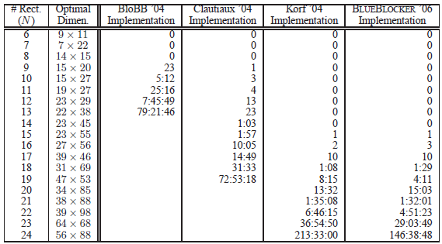

Slide 20
Incremental Minimal Bounding Box Problem
Comparable to the previous best solver on the problem that solver was tuned for.
Both of the best solvers come from a CSP representation of the problem.
The 2nd best solver is also a CSP solver. It uses a bitmap to draw the boxes to keep track of their positions

Slide 21
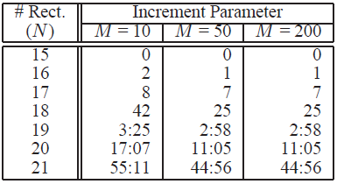
Larger blocks do not slow down the solver.

Slide 22
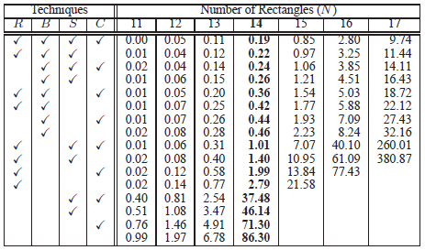

Slide 23
Technique Effectiveness
Semantic branching has the largest effect.
When semantic branching is enabled, symmetry breaking has the next largest impact
When semantic branching is disabled, removal of subsumed variables is more important.
Clique detection the least, but at least 15% for the N = 17 test

Slide 24
Experimental Results Summary
Comparable to the best known solver for the specific problem of finding the minimum-area rectangles with increasing square size
More flexible than the best known solver
Able to handle larger rectangles without any loss of performance
Found that the semantic branching concept has the biggest affect

Slide 25
Questions?

