Slide 1
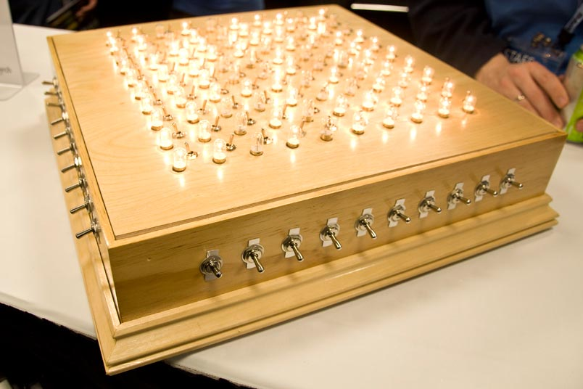
Constraint Models for the Covering Test Problems
Authors: Brahim Hnich, Steven D. Prestwich, Evgeny Selensky, Barbara M. Smith
Speaker: Pingyu Zhang
CSE 990 Advanced Constraint Processing, Fall 2009

Slide 2
Outline
Introduction & background
CSP model
  Naïve model, Alternative model, Integrated model
Symmetry breaking
Solving the CSP
  Setting up the Ilog Solver, Experiment results
SAT Model
  Model, Experiment results

Slide 3
The Combinatorial Testing Problem
A combinatorial problem
  A machine with 10 switches, each with two positions
  2¹⁰ possible combinations to be tested before shipping!
Real world problems
  Software interaction testing
  Hardware testing
  Testing of advanced materials
  Interactions regulating gene expressions

Slide 4
Optimization Problem: CA(t,k,g)
Given
  A set of k software ‘components’ to be tested
  Each component can take g different values (alphabet)
  A covering strength t
Find
  the minimum number of tests, b
  Such that every combination of t components appears in some test
k=5
b=2
b=?
t=3

Slide 5
Mathematical Object: Covering Array
Given: CA(t, k, g) of size b: b×k array
  k: # of parameters
  g: size of the alphabet
  t: covering strength: for every subset of t parameters,
  each value combination appear at least once
  Example CA(3, 5, 2), 2⁵=32? b=10 does it!
Goal: Minimize b – Unfortunately, NP hard

Slide 6
How about solving it with CSP
Challenges
  How to model the problem into a CSP?
  How to setup a solver?
The general framework
  Step 1: guess a CA size b
  Step 2: encode the problem as a CSP and try to solve it
  Step 3:
    if the CSP is solvable, reduce b by some value and repeat Steps 1—3 .
    If CSP is not solvable, enlarge b by some value and repeat Steps 1—3.
  The smallest solvable b is the optimum size.

Slide 7
Outline
Introduction & Background
CSP model
  Naïve model, Alternative model, Integrated model
Symmetry breaking
Solving the CSP
  Setting up the Ilog Solver, Experiment results
SAT Model
  Model, Experiment results

Slide 8
A Naïve Matrix Model
Rows Each variable represents the value of one parameter in one vector: b×k matrix
  Example: k=5 (x_{i1..5}), g=2 (0/1), t=3 (every combination of three parameters), b=5 (a total of 5 combinations/rows)
How to express constraints?
  Every subset of t parameters must be combined in all possible ways

Slide 9
A Naïve Matrix Model
Each variable represent the value of one parameter in one vector: b×k matrix
How to express constraints?
  Every subset of t parameters must be combined in all possible ways
  Introduce additional boolean variables
Describes the situation where x₁, x₂, x₃ are assigned 0 at vector 1

Slide 10
A Naïve Matrix Model
Each variable represent the value of one parameter in one vector: b×k matrix
How to express constraints?
  Every subset of t parameters must be combined in all possible ways

Slide 11
A Naïve Matrix Model
Each variable represent the value of one parameter in one vector: b×k matrix
How to express constraints?
  Every subset of t parameters must be combined in all possible ways
  Question: How many columns are there for this example?

Slide 12
A Naïve Matrix Model
Each variable represent the value of one parameter in one vector: b×k matrix
How to express constraints?
  Every subset of t parameters must be combined in all possible ways.
  Express coverage constraints over columns (in general, columns)
  Clearly, this is not very efficient…

Slide 13
Alternative Matrix Model
What did we learn from last model?
  Setting up variables is simple and straightforward.
  Expressing constraints is cumbersome and introduces numerous assistant variables.
Each variable represents a t-tuple in a vector (compound variable), domain is all possible values for the tuple.
Domain of C_{1,1} | Assignments for x₁, x₂, x₃
0 | 0, 0, 0
1 | 0, 0, 1
2 | 0, 1, 0
3 | 0, 1, 1
4 | 1, 0, 0
5 | 1, 0, 1
6 | 1, 1, 0
7 | 1, 1, 1

Slide 14
Alternative Matrix Model
How to express constraints?
  Now, each column represents all assignments for one specific tuple.
  In each column, every number in the range 0 to 2^{t} -1 should appear at least once, and at most…
  Question: How many times each number appears at most in a column?
  Enforcing such a global constraint on each column. ( constraints in total)

Slide 15
Alternative Matrix Model
Improvement over the last model?
Are we done?

Slide 16
Alternative Matrix Model
Intersection Constraints
  Values assigned to compound variables in the same vector should be consistent.
  In every row, if two variables share some positions, we impose a binary constraint stating the allowed pairs of values.
Allowed tuples
(0,0), (0,1), (1,0), (1,1), (2,2), (2,3), (3,2), (3,3), (4,4), (4,5), (5,4), (5,5), (6,6), (6,7), (7,6), (7,7)

Slide 17
Alternative Matrix Model
How many Intersection Constraints for each row?
  For each compound variable, # of variables sharing ONE position is
  # of variables sharing TWO positions
  Continues until the case of sharing (t-1) positions
For the CA(3, 5, 2) example
  # of variables sharing ONE position is 3
  # of variables sharing TWO positions is 6
  10 variables in each row, (3+6)×10/2 = 45 constraints.

Slide 18
Alternative Matrix Model
How many Intersection Constraints for each row?
  Reduction 1: the red constraint is redundant with the conjunction of the two blue constraints and it can be removed.
  In general, constraints between variables that share fewer than t-1 positions in common, can be removed.
1,2
1,4
1

Slide 19
Alternative Matrix Model
How many Intersection Constraints for each row?
  Reduction 2: a clique can be reduced to a path.
  The savings are more obvious if k gets bigger.
1,2
1,2
1,2
(1, 2, 3)
(1, 2, 3)
(1, 2, 7)
(1, 2, 4)
(1, 2, 7)
(1, 2, 4)
(1, 2, 6)
(1, 2, 5)
(1, 2, 6)
(1, 2, 5)

Slide 20
Alternative Matrix Model
How many Intersection Constraints for each row?
  Apply reduction 1: 45 → 30

Slide 21
Alternative Matrix Model
How many Intersection Constraints for each row?
  Apply reduction 1: 45 → 30
  Apply reduction 2: 30 → 20

Slide 22
Alternative Matrix Model
Still, the # of intersection constraints is a problem ☹
  Why not apply the intersection constraints on the naïve model?
To summarize so far
  Naïve model suffers from # of additional variables.
  The alternative model suffers from # of intersection constraints.
  Can we combine the strengths together?
Implicit connections

Slide 23
Combining them together: an Integrated Model
Channeling constraint
  explicitly express connections between compound variable and its corresponding t variables in the naïve model.
  There are totally channeling constraints, each with arity t+1.
  Enforcing GAC on them leads to assignment of x or domain reduce of c
  Eliminate all intersection constraints.
Extensionally | (0,0,0,0), (1,0,0,1),(2,0,1,0),(3,0,1,1),(4,1,0,0),(5,1,0,1),(6,1,1,0),(7,1,1,1)
Intensionally | C_{1,1}=4x₁₁+2x₁₂+x₁₃

Slide 24
Outline
Introduction & Background
CSP model
  Naïve model, Alternative model, Integrated model
Symmetry breaking
Solving the CSP
  Setting up the Ilog Solver, Experiment results
SAT Model
  Model, Experiment results

Slide 25
Symmetry
CA has both row and column symmetries: any two cols/rows
Another less obvious symmetry: value symmetry
Size of the symmetry group:
  So we must deal with them!

Slide 26
Symmetry Breaking
For row and column symmetries
  [Flener02] Theorem1: For a matrix model with row and column symmetry in some 2-d matrix, each symmetry class of assignments has an element where both the rows and the columns of that matrix are lexicographically ordered.
  Naïve model: Impose lexicographical ordering constraints on both rows and columns of the matrix
  Alternative model: rows are the same, columns are not as powerful, but can be help
  Integrated model: can apply lexicographical ordering on either original or alternative matrix, but not both.

Slide 27
Symmetry Breaking
For value symmetries
  Very simple: force the first row to be all 0s (no matter which model)
  It does not conflict with row/column symmetry-breaking constraints (the first row is lexicographically smallest anyway)
  Triggers better propagation.

Slide 28
Outline
Introduction & Background
CSP model
  Naïve model, Alternative model, Integrated model
Symmetry breaking
Solving the CSP
  Setting up the Ilog Solver, Experiment results
SAT Model
  Model, Experiment results

Slide 29
Setting up the solver
Use ILOG Solver 6.0
Use compound variables as search variables
  Coverage constraints expressed over compound variables
Variable and value ordering
  Values assigned in ascending order
  Labeling variables by column (coverage constraints are on columns)
  Lexicographical ordering within each column
Symmetry-breaking constraints (as shown before)
Channeling constraints
  Extensional: GAC
  Intensional: bounds consistency
  Same for domain of binary alphabet: each value is a bound. However, solver may run faster on bounds consistency

Slide 30
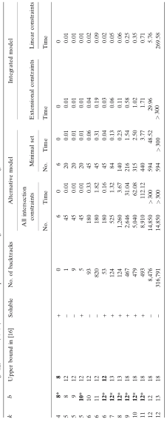
Experiment results
Results for CA(3, k, 2)
  For alternative model, both with all/minimal intersection constraints
  For integrated model, channeling constraints expressed both extensionally (GAC) and intensionally (bounds consistency).
  * indicates finding optimal size of b.

Slide 31
Experiment results
Results for CA(3, k, 2)
  For integrated model, enforcing intensional constraints is cheaper than enforcing extensional constraints.

Slide 32
Experiment results
Results for CA(3, k, 2)
  Integrated model is better than alternative model
  For k=12, integrated model has 220 channeling constraints, while alternative model has 594 non-redundant intersection constraints.

Slide 33
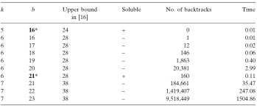
Experiment results
Results for CA(4, k, 2)
  Runtime limit is 1 hour (CA(4, 7, 2) for b=24 can’t finish in 1 hour).

Slide 34
Outline
Introduction & Background
CSP model
  Naïve model, Alternative model, Integrated model
Symmetry breaking
Solving the CSP
  Setting up the Ilog Solver, Experiment results
SAT Model
  Model, Experiment results

Slide 35
Local search model with SAT
Encoding the problem into CNF SAT (Example CA(2, 3, 2))
  Still have two matrices: original and alternative
  Create a Boolean variable for EACH value of EACH variable.
(1,2), (2,3), (1,3)

Slide 36
Local search model with SAT
(1)
Encoding the problem into CNF SAT
(2)
(1,2), (2,3), (1,3)

Slide 37
Local search model with SAT
(1)
Encoding the problem into CNF SAT
(2)
(3)
(4)
(1,2), (2,3), (1,3)

Slide 38
Local search model with SAT
(1)
Encoding the problem into CNF SAT
(2)
(3)
(4)
(5)
(1,2), (2,3), (1,3)

Slide 39
Local search model with SAT
(1)
Encoding the problem into CNF SAT
(2)
(3)
(4)
(6)
(5)
(1,2), (2,3), (1,3)

Slide 40
Local search model with SAT
(1)
Encoding the problem into CNF SAT
(2)
(3)
(4)
(6)
(5)
(1,2), (2,3), (1,3)

Slide 41
Local search model with SAT
(1)
Encoding the problem into CNF SAT
(2)
(3)
(4)
(6)
(5)
(1,2), (2,3), (1,3)

Slide 42
Setting up the solver
SAT local search algorithm
  First, randomly assign all boolean variables.
  Select a violated clause, flip the value of one variable in it (satisfy the clause, but may cause others to violate).
  Repeat until timeout or satisfied.
Variable selection heuristic
  With probability p, randomly select a variable. (noise, set to .2, .3, .4)
  With 1-p, pick variable with min score
  Break ties by selecting the variable that was least recently flipped.
  Freebie move: if there are multiple variables such that flipping them would not create new unsat clauses (score=0), break ties randomly.
Smallest negative effect
Prefer variables that have fewest flips
# of unsatisfied clauses results from flipping v
Score =
total # of flips in the past on all variables other than v

Slide 43
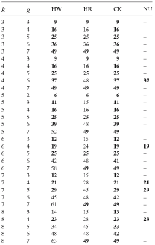
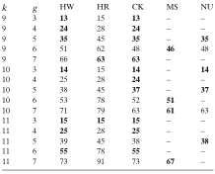
Results for local search model: CA(2, k, g)
*bold denotes best results.
HW: HWFSAT (2006)
HR: Hartmann & Raskin 2004
CK: Chateaunef & Kreher 2002
MS: Meagher & Stevens 2005
NU: Nurmela 2004

Slide 44
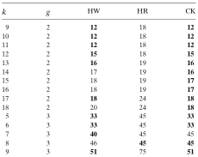

Results for local search model
CA(3, k, g)
CA(4, k, g)
Better than the other 2
In fact, they are optimal, but do we know they are optimal?

Slide 45
Summary
Modeling CA problem into CSP
  Naïve model
  Alternative model
  Integrated model
Local search with SAT
  Handles larger problems
  Trade scalability with completeness
  Combining results with CSP results may be valuable

Slide 46
Small Typos in Paper
Page 203, first formula:
Page 203, fifth line from bottom: variables
Page 212, 20th line from top:

Slide 47
Literature
References
  Hnich et al. ‘06: Constraints models for the covering test problems
  Flener et al. ‘02: Breaking row and column symmetry in matrix models
  Frisch et al. ‘02: Global constraints for lexicographical orderings
  Gent et al. ‘95: Unsatisfied variables in local search
  Hartman et al. ‘04:Problems and algorithms for covering arrays
  Chateauneuf et al. ‘02: On the state of strength-three covering arrays
  Meagher et al. ‘05: Group construction of covering arrays
  Nurmela et al. ‘04: Upper bounds for covering arrays by Tabu search
The switches and light bulbs shown on first slide is a real game
  http://www.devicedaily.com/gadgets/awesome-wooden-switch-and-bulb-game-resurrects-1960s-idea.html

Slide 48
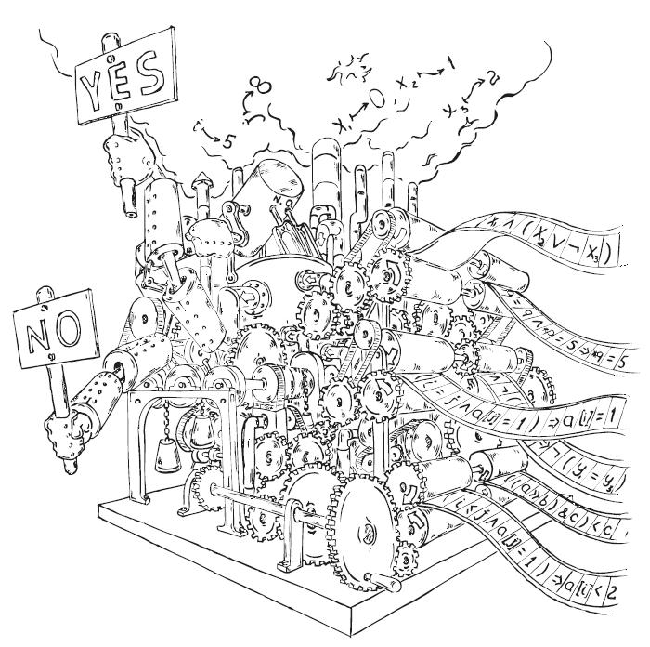
Discussion

